Slide 1
Applied Deep Learning
Spring, 2021
加簽規則

Slide 2
Task #0: GPU
If you don’t have access to any GPU computing resource, then it is near impossible for you to finish the homeworks in this course.
Make sure you have GPU resources before 加簽.
Recommended free GPU resources: kaggle, colab

Slide 3
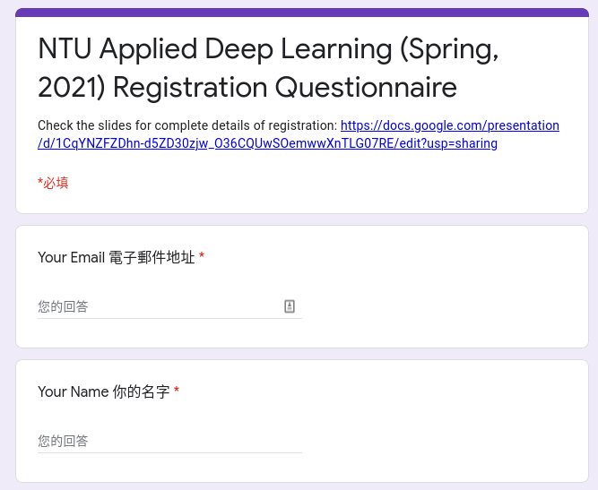
Task #1: Questionnaire
Fill in the questionnaire.
https://forms.gle/TwAtutYuvGbAAipP7.

Slide 4
Task #2: HW0 - Data
Text sentiment classification.
Data examples
Input - “不管 再 怎麼 努力 都 沒有用”
Label - 0 (negative)
Input - “我 很 感謝 你 借 我 安全帽 ！”
Label - 1 (positive)
The input text is already segmented and seperated by whitespaces.
Evaluation metric: accuracy of the “Category” field.
Download the data from Kaggle.

Slide 5
Task #2: HW0 - Requirements
Implement and train
a binary classification model
that takes bag-of-words vector as input,
and consists of linear layers,
with TensorFlow or PyTorch.
0 or 1
Prediction
Linear Layers
MLP
我
很
你
借
！
再
都
感謝
不管
怎麼
努力
沒有用
安全帽
bag-of-words vector
2
1
1
1
2
0
0
1
0
0
0
0
1
Input text
“我 很 感謝 你 借 我 安全帽 ！”

Slide 6
Task #2: HW0 - Kaggle
Kaggle: https://www.kaggle.com/t/e3941006354145b59f880ca7e4d0127c.
Your Kaggle (team) ID (that shows on the leaderboard) must start with your student ID following by an underscore. [Student ID]_XXXXX, e.g. R08922065_TOTHEMOON.
You can only submit 5 predictions per day.
Pass the baseline on public and private leaderboard.

Slide 7
Task #2: HW0 - What You Can Do
Train with the data we provide.
Use python 3.6 and above.
Use the following packages/tools:
PyTorch, TensorFlow
numpy, tqdm, pandas
If you want to use other package, contact TA via email.

Slide 8
Task #2: HW0 - What You Can NOT Do
Any means of cheating or plagiarism, including but not limited to:
Use the labels of the test data directly or indirectly. (Do not try to find them.)
Use package or tools not allowed.
Use model trained with other data.
Give/get code to/from others.
Give/get trained model to/from others.
Give/get model prediction to/from others.

Slide 9
Task #2: HW0 - Code Submission
Submit your code as a zip file here.
Name the zip file as [Student ID].zip, e.g. R08922065.zip.
After unzipping, there should be a directory with your student ID as its name, and containing the following files
README.md (describing how to run your preprocessing/training/predicting code).
Any code/script.
DO NOT include your model checkpoints or data in the zip file.

Slide 10
Rules
Please complete all the tasks before 2021/2/27 23:59 in order to be on the consideration list.
It is not guaranteed that you can enroll in this course even if you complete all the tasks. We reserve the right to decide the final 加簽名單.
Contact adl-ta@csie.ntu.edu.tw if you have any questions with subject starting with “[HW0]”. Please DO NOT reach out to TAs via their personal contact.

Slide 11
FAQ
We will update this page based on the questions we receive.
Please check this page before contacting us.
Can we use dropout or activation layers?
Yes.
Can we use scikit-learn? (Added on 2/23)
No.
Can we use os, logging, multiprocessing, etc? (Added on 2/23)
You are allowed to use any package included in the Python standard library.

Slide 12


Links to HW0 Slides and PyTorch Tutorial
https://bit.ly/2ZuJuwY
https://bit.ly/3dzrF8q

